Slide 1


SAP UI5 & FIORI with OData TRAINING using BAS
Anubhav Oberoy
Day – 4

Slide 2

Agenda – Day 4
Creating a Simple node project
Creating basic function in Node JS
Creating Reusable modules
Reading files in NodeJS using the fs module
Steps to Create a Fresh Node Project
Serving our files using express module
Serving an application using Node JS
Introduction to jQuery
Introduction to UI5
Responsive Web Design
Structure of UI5 Framework
MVC Architecture.
Project Structure of UI5 Project.
First UI5 Project
Introduction to UI5
Responsive Web Design
Structure of UI5 Framework
Introduction to UI5 SDK
MVC Architecture.
Project Structure of UI5 Project.
First UI5 Project
Views In SAP UI5
Initializing JS view
What is Controller?
Structure of controller
Creating our first controller
How UI5 framework works
Basics of controller
Basics of OOPS
Concept of Control Hierarchy
XML View

Slide 3
Steps to create a Fresh NodeJS Project
Run a command called npm init – Create a new Nodejs project
Answer some simple questions like project name, starring file, author, version, description, …
We can give any name to our starring file, but it is recommended to use index.js to follow the best practices.
Create the index.js file.
We can just add some code to this file. Ex: console.log(‘Welcome to anubhav trainings’);
To run the project, we can use the ‘node .’ command in the terminal.
Steps to use an external library using NodeJS
Find the library (module) of your purpose on NPM and check its documentation
To add that module/library as a dependency in our project use the command npm install moduleName
The above command we add that dependency to the package.json file.
Use require statement to use the dependency.
const obj = require(‘moduleName’);
Note:-
When we share our project with other developers then we don’t ship the node_modules with our project. The name of all the required dependencies will be there in the package.json file.
When we setup our project in a new system, we just have to run the npm install command, and it will read the package.json file and install all the dependencies.
npmjs
npm install
Laptop
Project+
Module
Laptop
Project

Slide 4
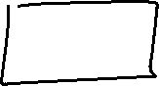
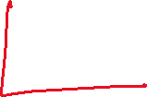

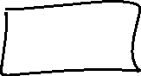

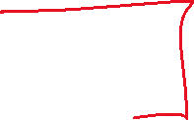









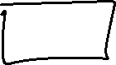








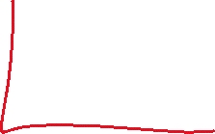
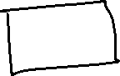


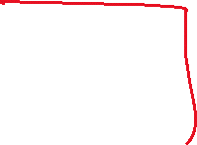


Slide 5
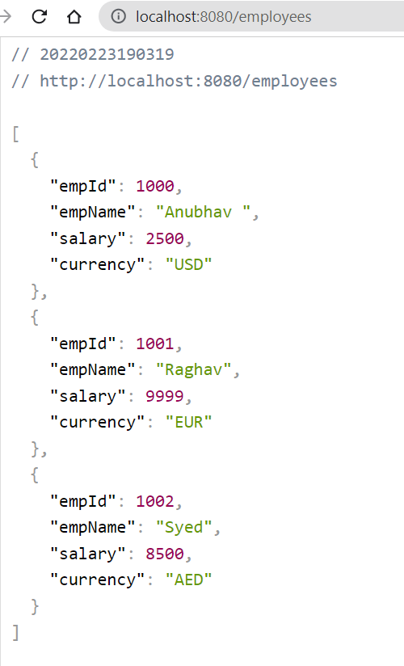
Hands – on: Start a Local Server using Express
Once our Node project is initiated, Now we need to start a local server using the Express module of NodeJS.
But first we need to add this module as a dependency. To add it run the command npm install express.
You can see the express documentation for more details: https://www.npmjs.com/package/express
We will also create local API using the NodeJS
Code Link:
index.js

Slide 6
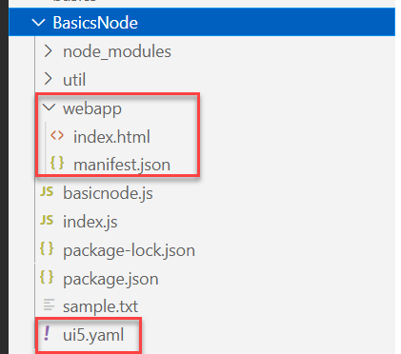
Hands – on: Starting an App using NodeJS
Now we will serve a basic html page on the local server with the help of ui5 tooling.
But before we start we have to install a few dependencies:
ui5 cli:- npm install @ui5/cli to install globally: npm install -g @ui5/cli
ux-ui5 tooling:- npm install @sap/ux-ui5-tooling to install globally: npm install –g @sap/ux-ui5-tooling
Now we have to create a webapp folder in our node project folder, and in that webapp folder create two files index.html and manifest.json.
Also create a ui5.yaml file in the project folder.
Add the required code in all the files form the links provided below.
Now to run the project use command: ui5 serve
Code Links:
index.html
manifest.json
ui5.yaml

Slide 7

Introduction to jQuery
jQuery is a java script library, which is used to simplify our JS code.
The moto is to minimize JS code size.
Why we use jQuery?
It’s free to use (Open Source)
Used by top software companies like google, Netflix, etc.
Light weight JS library
jQuery greatly simplifies JavaScript programming.
Available on internet
Purpose is to write less and do more
Industry standard
How to use?
Download the jQuery library and keep it in our project, just like we use util/mycode.js
Reference jQuery from CDN (Content Distribution/Delivery Network) – directly reference it from internet
Documentation of jQuery is available @ https://jquery.com

Slide 8
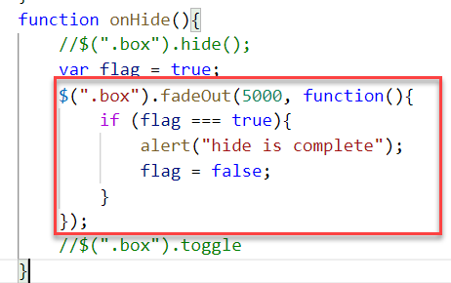
Syntax of jQuery
The jQuery syntax is tailor-made for selecting HTML elements and performing some action on the element(s).
Basic syntax is:
$(selector).action()
$ sign indicated to the browser that we want to use jQuery.
selector: selector is same what we have seen in CSS i.e., #id, .class, tagName
Action(): It is a JavaScript Event or Action which we want to perform on the selected element.
Example:
$("p").hide() - hides all <p> elements.
$(".test").hide() - hides all elements with class="test".
$("#test").hide() - hides the element with id="test".

Slide 9
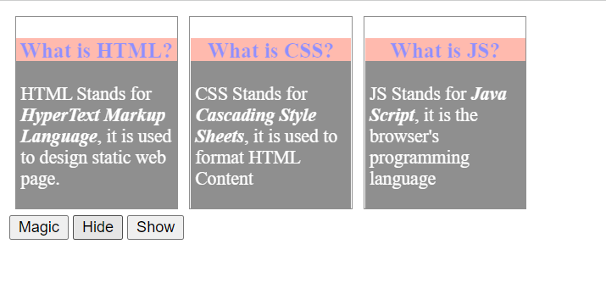
Hands – on: Adding effects using jQuery
Create a new file named jQBasic.html in the Basics folder which we have used for html, css and JavaScript.
Bring the code related to the box and box-content form the previous example.
Now we will add some effects to these boxes using the jQuery actions.
Code Link:
jQBasics.html

Slide 10
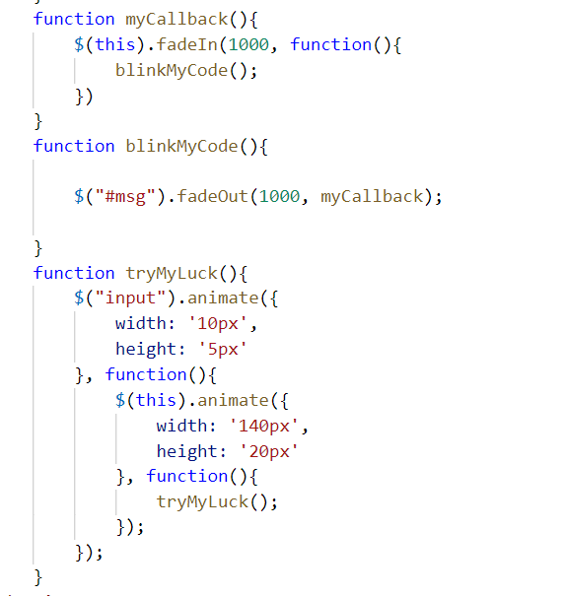
Hands – on: Adding Animation
Now we will add some animations to our html page using the jQuery.
For this we have to bring back the login fields code back form the previous examples.
Code Link:
jQBasics.html

Slide 11

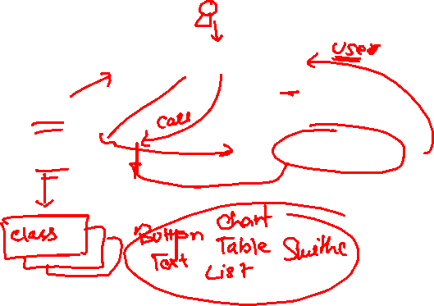
Introduction to UI5
SAPUI5 (SAP user interface for HTML5) or Open UI5 is a collection of libraries that you can use to build desktop and mobile applications that run in a browser. With the SAPUI5 JavaScript toolkit, you can create web applications using HTML5 web development standards.
SAP UI5 is a framework which is used to develop Responsive web applications to run on any platform, any browser and any OS.
Framework: - A framework is a platform for developing software applications. It provides a foundation on which software developers can build programs for a specific platform.
A framework consists of libraries that can be used to process input, manage hardware devices, and interact with system software.
Library: - A collection of Classes.
Classes: - Collection of methods, Attributes, Events.
Your Code
You call the library
Framework call you
Libraries
Framework
Contains

Slide 12

Responsive Web Design
Responsive web design (RWD) is a web development approach that creates dynamic changes to the appearance of a web application, depending on the screen size and orientation of the device being used to view it.
Responsive Web Design is about using HTML and CSS to automatically resize, hide, shrink, or enlarge a website to make it look good on all devices (desktops, tablets, and phones).
Now a days, all the frameworks are designed to adapt the UI according to the screen size of the device.

Slide 13
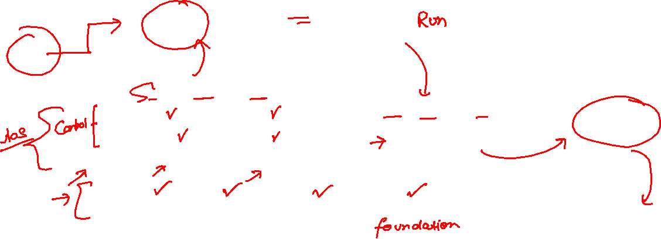
Structure of UI5 Framework
The UI5 framework is built on top of open standards like HTML5, CSS, JS, and jQuery. UI5 Framework composed of two major components.
1.Design Time Components: It helps us to designing a new application from scratch , it consists of lots of libraries which help to design our application.
2. Runtime Components: It consists of the renderer which is helpful for the conversion of ui5 code into the browser friendly code(HTML+CSS+JS)
The Browser only Understand the HTML , CSS , JavaScript.
BAS or VS Code
App
Creating a App
Using the Libraries
The Runtime component converts the code of application to
SAP UI5 Design Time Component
SAPUI5 Runtime Component
HTML+CSS+JS
sap.m
sap.ui.comp
sap.ui.table
sap.ui.layout
Renderer
sap.ui.core
sap.ui.unified
sap.ui.core.mvc
The browser will now understand the code.
HTML5
CSS
JS
jQuery
Browser

Slide 14
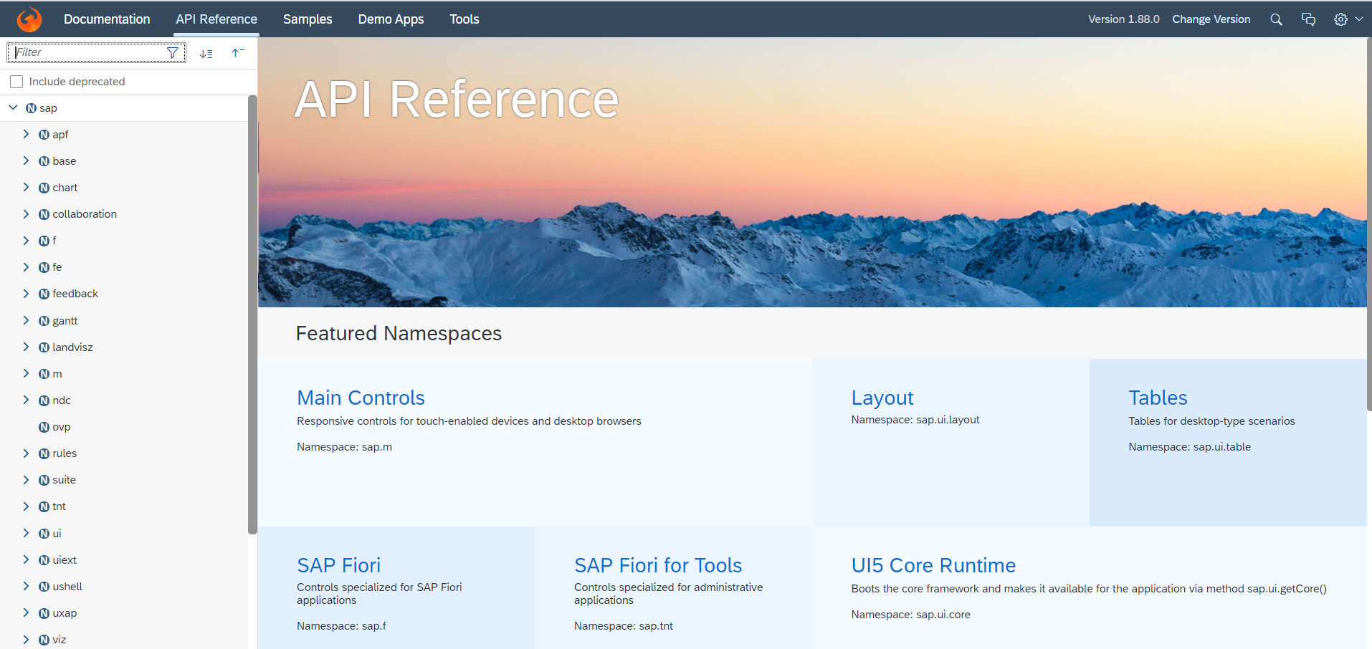
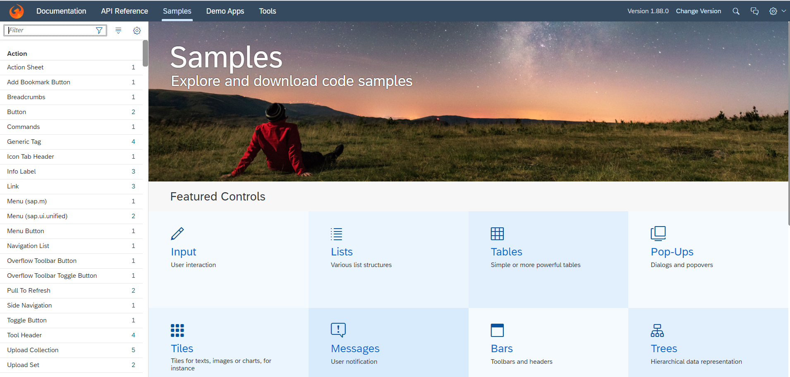
Introduction to UI5 SDK
Documentation of SAP UI5 is available at the SAPUI5 Software Development Kit.
We can access the SAP UI5 API’s at the Documentation page of SAP UI5 or you can use the link to go to sap’s API screen - https://sapui5.hana.ondemand.com/#/api
We can directly search the required api’s on the SDK.
SDK contains the sample of all the controls which we can use in UI5
SAP UI5 API reference screen
SAP UI5 Sample reference screen

Slide 15
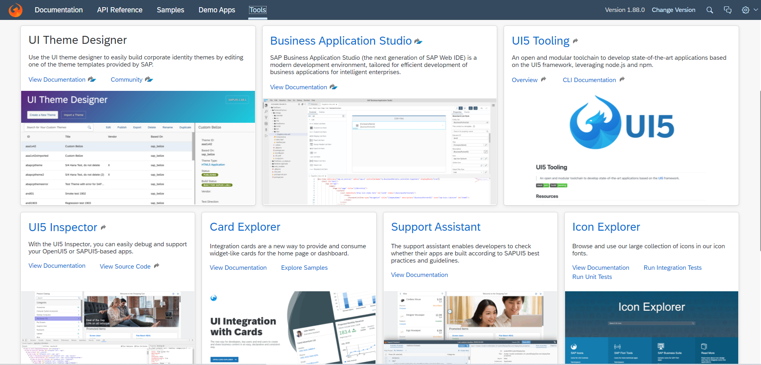
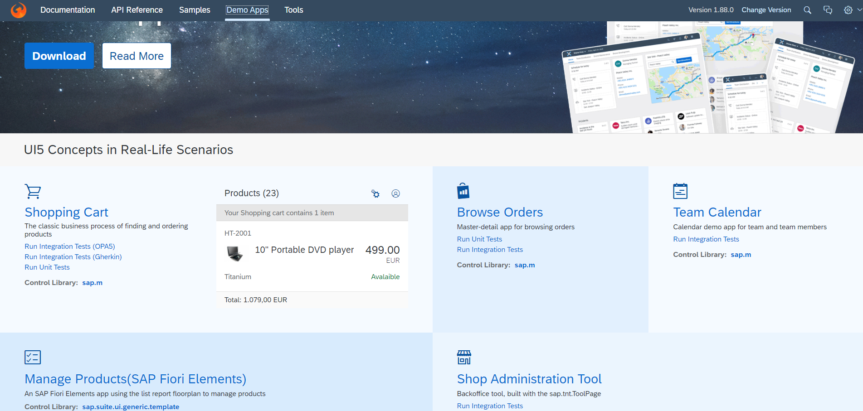
UI5 SDK continues…
UI5 SDK contains tools to make the development smooth for the developers.
It has UI5 icon packs which can be directly accessed for the UI5 SDK’s Tool Screen (Link).
SAP UI5 SDK provides us the demo application, So we can get an idea about how to create different type of applications using UI5 controls
UI5 SDK Tools Screen
UI5 SDK Demo Apps Screen

Slide 16
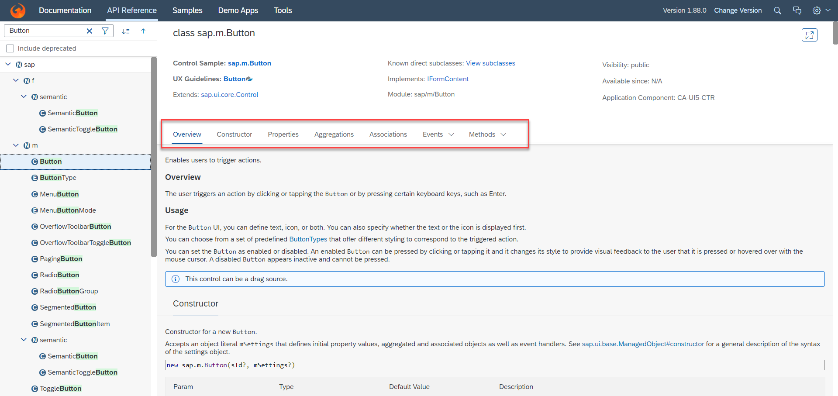
UI5 SDK continues…
When we search and open any API we see a screen similar to one which is shown below.
Every API contains different kind of:
Properties,
Aggregations,
Associations,
Events,
Methods

Slide 17
MVC Architecture
MVC Stands for Model , View and Controller.
MVC is a design pattern used in software industries to build applications.
1. Model: It holds the data of the application inside itself.
2. View: It is the output and input interface of the application or can say it is the user interface .
3. Controller : It has all the processing logic inside itself (all written in JavaScript).
The Controller has a event handler to handle the triggered event
eventHandler()
Controller
[Processing]
All processing logic is written in JavaScript because browser only understand JavaScript.
Model will notify the controller back again with the data.
If the event need the data it request the model for the data
The View Triggers a event to the controller.
<<Event>>
The controller get the data and notifies the view back
If we want direct interaction between view and model we use data binding
Model
[Data]
View
I/O
Data Binding
User

Slide 18
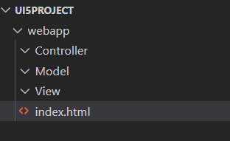
Project Structure of UI5 Project
When you create a new SAPUI5 application, you will be able to see a folder structure created in your project explorer like below.
In a SAP project there are a number of folders and files that you will not recognize if you are not familiar with MVC. Let's have a quick overview.
Within a given project inside the webapp folder , you have three core folders
Model
View
Controller
webapp folder : webapp folder is the root folder of the application in which all the core folders and files of the application were kept.

Slide 19
First UI5 Project in VS Code
Pre-requisites:
We must have node.js v14 or above installed in our system.
We must have sap ui5 tooling installed in our system
npm install –g @ui5/cli (ui5 command line tool)
npm install –g @sap/ux-ui5 tooling (Fiori command tools)
Both are pre-installed in BAS (Business Application Studio)
App creation:-
Initialize a UI5 project , Create a Folder for your project (UI5project) .
We need to create a webapp folder inside our project folder.
inside webapp folder create a manifest.json file
inside manifest.json file create “sap.app”
{
“sap.app”:{
“id”: “mickey”
} }
Now Initialize a node project , In the project terminal run command npm init (auto generate a package.json file).
Now run ui5 init command inside the terminal (ui5.yaml file will generated automatically)
Id is the identifier of the project.
You can give any name as a pet name of the webapp folder

Slide 20
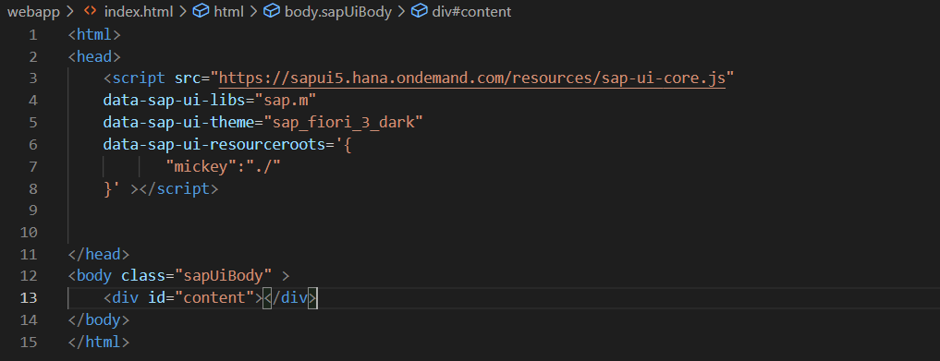
First App Continues……
App-Code:-
Create index.html , load the sapui5 framework from CDN and specify the properties like library and theme
Inside the terminal run command fiori run --open index.html to run your application on the browser.
This is also know asUI5 Bootstrap Code used to initialize the UI5 Framework initially
Here we have to also mention the namespace of the application

Slide 21
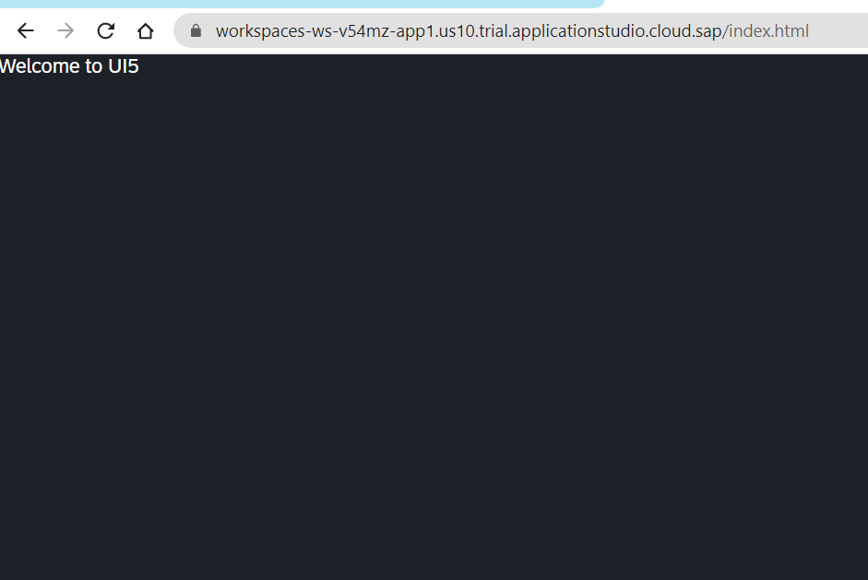
Hands on – Initialize first UI5 Project
Initialize a new ui5 project using the steps mentioned in the previous slide.
Code Link:-
index.html
manifest.json

Slide 22
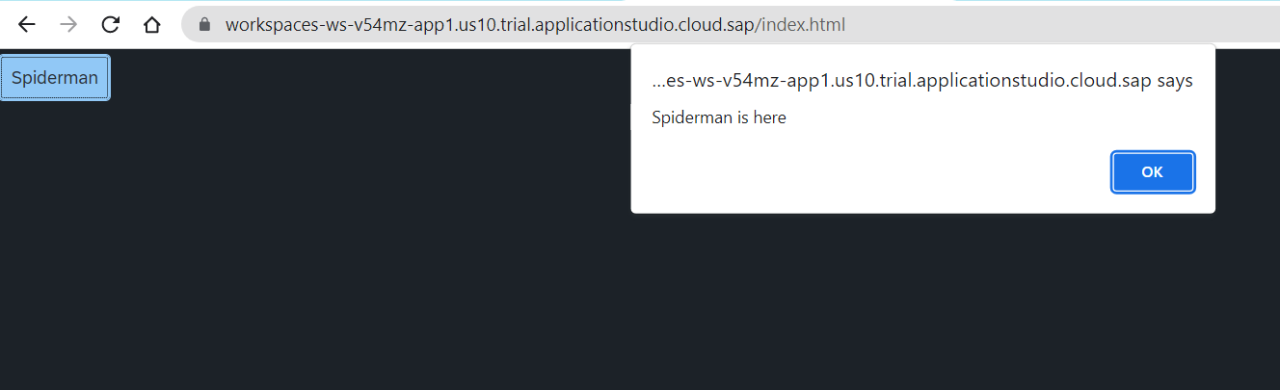
Hands – on: Create a Simple Button Control
Now we will add a simple button control to our app an on press of that button a alert message will be shown to the user, with message “Spiderman is here”.
Code Link:-
index.html

Slide 23
Views in SAP UI5
View is responsible to manage information display to the users.
Views are based on Model.
There are Four types of views in SAP UI5, these are listed below:
XML View:- It is in the XML format. The file name ends with the extension “.view.xml”. There are no predefined methods in the XML view.
JS View:- It is in JavaScript format. The extension of the view file is “.view.js”.
JSON View:- It is in JSON format. The file name ends with the extension “.view.json”.
HTML View:- It is in HTML format. The file name ends with the extension “.view.html”. Here we create the controls within the <div> tags, as we do while developing HTML pages.
Percentage Usage of Views:
2%
98%
JSON View – 0%
HTML view – 0%
JS View is used only in 2% of the views.
XML Views are the mostly used views now a days.
The use of JSON and HTML views are negligible

Slide 24
Initializing our First View (JS View)
Syntax of initializing a control in UI5
var objectName = new libraryName.className(sId, oProperties);
sId → unique id of our control
oProperties → are the information about the class in an object format.
Syntax of initializing a view
var oView = new sap.ui.view({
id: ‘’,
viewName: ‘’,
type: ''
});

Slide 25
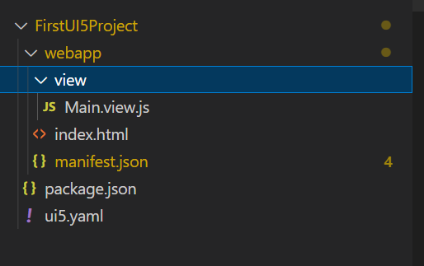
Hands – on: Initialize First View
Now create our first view.
Along with that we will add a button in the view using js view.
Code Links:-
index.html
Main.view.js

Slide 26
What is a Controller?
In SAPUI5 except the view, all the JS files will follow a special syntax to create a class (module). As we all know that in software development, the entire solution is designed by creating multiple classes, these classes work together to run our solution. We have dependencies between our class. The syntax which we use is responsible for loading our dependent classes.
A controller is also a class, but since its special (controller) class, we also need to inherit a special SAPUI5 class to mark it as controller. The name of special class is sap/ui/core/mvc/Controller.
In JS we use extend keyword to perform inheritance.
A module name is derived from a class name in SDK by replacing every dot (.) with slash (/)
This syntax will load all the dependent classes asynchronously, this is why the syntax is called AMD like syntax (Asynchronous module loading). Also called scaffolding template.
Skeleton of any JS file in SAP UI5 – Considered as a class
sap.ui.define([“dependencies”, “dep2”, “dep3”],
function(oD1, oD2, oD3) {
--logic—
}
);
The Syntax of the controller has the AMD(Asynchronous Module Loading) like structure . This is also Know as Scaffolding Template
Modules

Slide 27
Structure of Controller
We define a simple controller as follows:
sap.ui.define([ "sap/ui/core/mvc/Controller" ],
function(Controller) {
"use strict";
return Controller.extend(“Address of Controller", {
// controller logic goes here
});
});

Slide 28
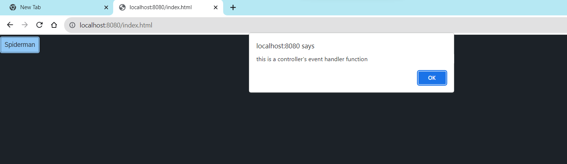
Hands – on: Create First Controller
Now to make our button work, we have to add some control logic to it, that logic will be written in the controller.
To add a controller to the project make a controller folder in the webapp directory and in that add a file named Main.controller.js.
In that file add the basic controller code in it and a function to show a alert message on click of the button.
Code Link:-
Main.view.js
Main.controller.js

Slide 29
How UI5 Framework works
Browser
CDN
SAP UI5 Framework
View
(Main.view.js)
controllerName=“…”
Call the controller Name
1
Index.html
3
The framework starts to find the controller with the same name
It will return controller name to the framework
var oView = new sap.ui.view({
viewName: “donald.view.Main",
type: “JS“
});
2
Loads the view
The object of the controller get all the controls .
6
8
Renderer
7
The view returns all the controls to the renderer
Controller
(Main.controller.js)
onInit() function
The renderer converts it into browser friendly language
Create the controller object
HTML + CSS
4
Call the constructor of controller
Get the object of the controller
5

Slide 30
Basics of Controller
A library name always starts with small letter and a Class name always starts with capital letter. Both will follow the camel case.
Enumerators are constant values, example for type of button we use enum ButtonType
For a control we have properties, aggregation, events, function name, they always follow camel case
A controller contains methods that defines how models and views interact.
Whenever we see a property for a control, we will always have setter and getter methods to manipulate and read the property value. E.g. an Input control has value property, we will have setValue and getValue method for the same.
In order to work with a control inside the controller, we need to obtain object of that control. To obtain the control object we must not use the document.getElementById because it will give the object of HTML control not the object of UI5 control.
To obtain UI5 element object, we need to first get View Object,
We will obtain the view object inside the controller using this.getView()
‘this’ is the object of my current class, so inside controller it will point to current class
We can now obtain the object of the control using this.getView().byId(controlId)
For every event in UI5, we have attachEvent, detachEvent, fireEvent methods as well, which can be used to link, delink and trigger event programmatically.

Slide 31
Basics of OOPS (Object Oriented Programing)
PASSENGER
+passport no +name +nationality
Walk(), talk(), print_boarding()
0..n
PLANE
+Airline +Width +Height
+fly(), +land(), #load()
ENGINE, WINGS
+capacity, +speed, +color
inheritance
PASSENGER PLANE
+no_of_seats
Load()
CARGO PLANE
+cargo_space
Load()
Association (relation between classes which are not of same group of family)
1. Aggregation – lose coupling, both objects can function independently, SHOULD have relation
2. Composition – tight coupling, both cannot function independently, MUST have relation

Slide 32
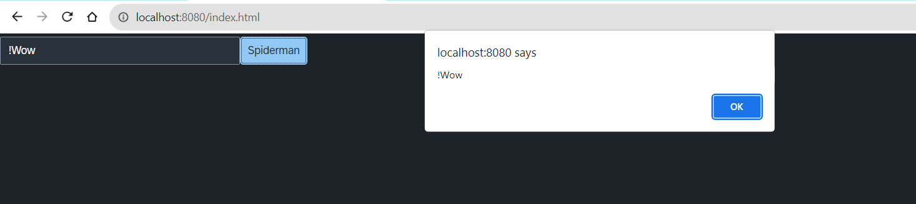
Hands – on: Input Field and Button Together
Now we will an Input field in the view.
On press of the button whatever is written in the input field will be displayed in the alert message.
Code Link:-
Main.view.js
Main.controller.js

Slide 33
Concept of Control Hierarchy
Concept of control Hierarchy tells us about how the SAP UI5 Controls are structure on the basis of the object oriented Paradigm.
Note:- Whenever we see a control, and if we are unable to find a property, association, event or function in that class, check its parent class.
sap.ui.base.ManagedObject
sap.ui.core.Element
sap.ui.core.Control
sap.m.Button
sap.m.InputBase
sap.ui.view
sap.m.Table
sap.ui.layout.form
sap.m.Input
sap.m.Column
SimpleForm
Some Frequently used Controls

Slide 34
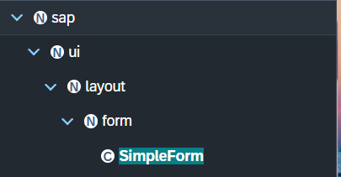
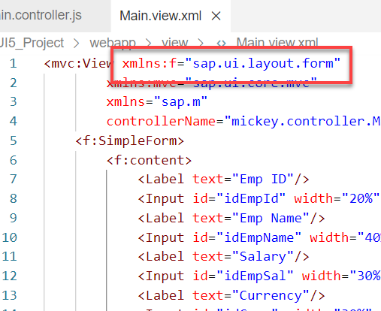
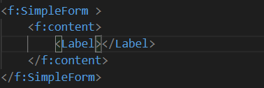
Basics of control hierarchy
To use any control , first we have to include controls’ parent class into the view
For example: To use the SimpleForm we have to include its parent class which is sap.ui.layout.form
The namespace have to given to the parent class
xmlns:f=“sap.ui.layout.form”
When we use the aggregation of any control same namespace will follow by the aggregation as parent.
The control name must start with capital letter and the aggregation name starts with small letter.
We have to check which control will aggregate to the control itself, if the aggregate control is the Control class or element class we can pass any of their child class to the aggregation.
for example:
As the <f:content> extend the element class we can use the <Label> which is also child of element class inside the <f:content>

Slide 35
XML View
What is XML?
XML stands for eXtensible Markup Language, it was originally developed to move data from one to another technology. It became popular to communicate between heterogeneous technologies.
XML is a tree data structure. Unlike HTML, we can use custom tags. Every programming language must support XML.
Portal
Java
App
ABAP
If_ixml
xml
xml
Data Objects → XML – Rendering
XML → Data Object – Parsing
Why XML View is better than other Views?
It is industry Standard.
XML handles the control id properly
XML rendering is faster
XML properly follows the MVC
Architecture.
JS view violets the principle of MVC due to which XML views are the preferred choice.

Slide 36
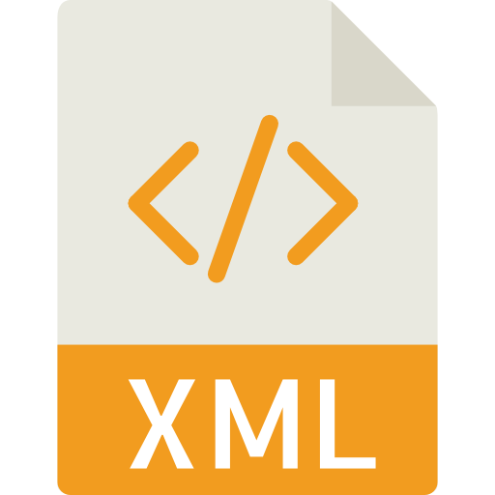
Structure of XML
<data>
<empStr>
<empId>5000</empId>
<empName>Jack</empName>
<salary>9500</salary>
<currency>EUR</currency>
</empStr>
<empTab>
<row>
….
</row>
</empTab>
</data>
Root Element
Child Element of <data> tag
Child Element of <empStr> tag
Skeleton of XML View
<mvc:View xmlns:mvc=“sap.ui.core.mvc” xmlns=“sap.m” controllerName=“pathOfContro.”>
<Button text=“Click Me”></Button>
</mvc:View>

Slide 37
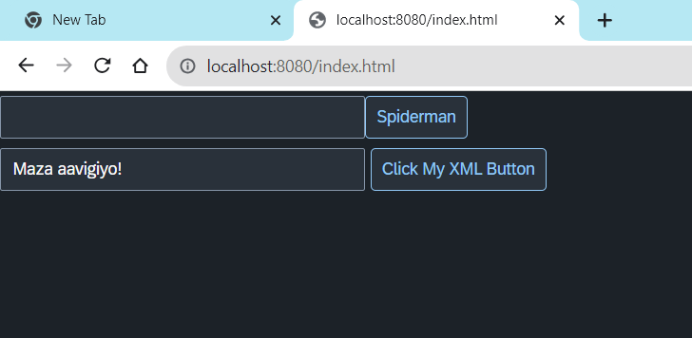
Hands – on: Create First XML View
Now we will create our first XML view.
For that create a new file ‘MyXML.view.xml’ in the view folder of the webapp directory
Then add the View code to this file and save. It will show a button on the screen.
Code Link:-
index.html
MyXML.view.xml
Main.controller.js

Slide 38
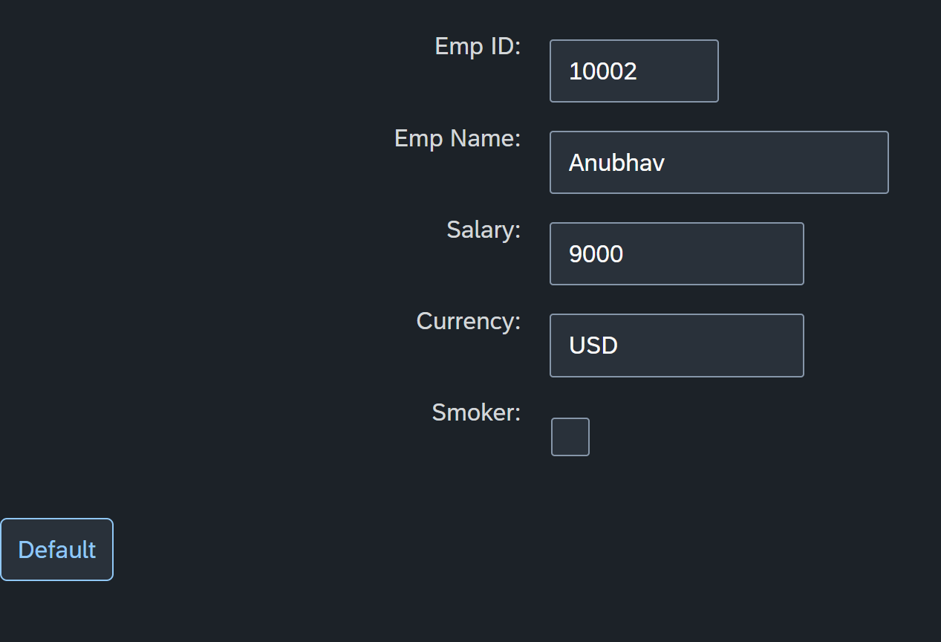
Hands – on: Simple Form Control
Now create a Simple form control in the View.
Along with that we will add a button below the Simple form and on press of that button change the value of one field in the Simple form.
Code Links:-
Main.view.xml
Main.controller.js

Slide 39

End of Day 4

Slide 40

Questions

Slide 41

Shekhar Vedi

Slide 42


We’re committed to empower you to be
Most Desirable Resource
through powerful training solutions.
We build the workforce of the future.
250+
Corporate Clients
30,000+
Learners Trained
25000+
Learners Placed
FREE WEBINARS
Sign up for free webinars with industry experts every fortnight!
Enroll Now!
Contact us today!
https://anubhavtrainings.com/

Slide 43




More from AnubhavTrainings.com

Slide 44
Title
Content

